Slide 1
Modern Publishing Tools for Modern Science
An open-source web app of the 2021 Nutrient Requirements of Dairy Cattle Dave J. Innes, Braeden G. Fieguth & John P. Cant

Slide 3
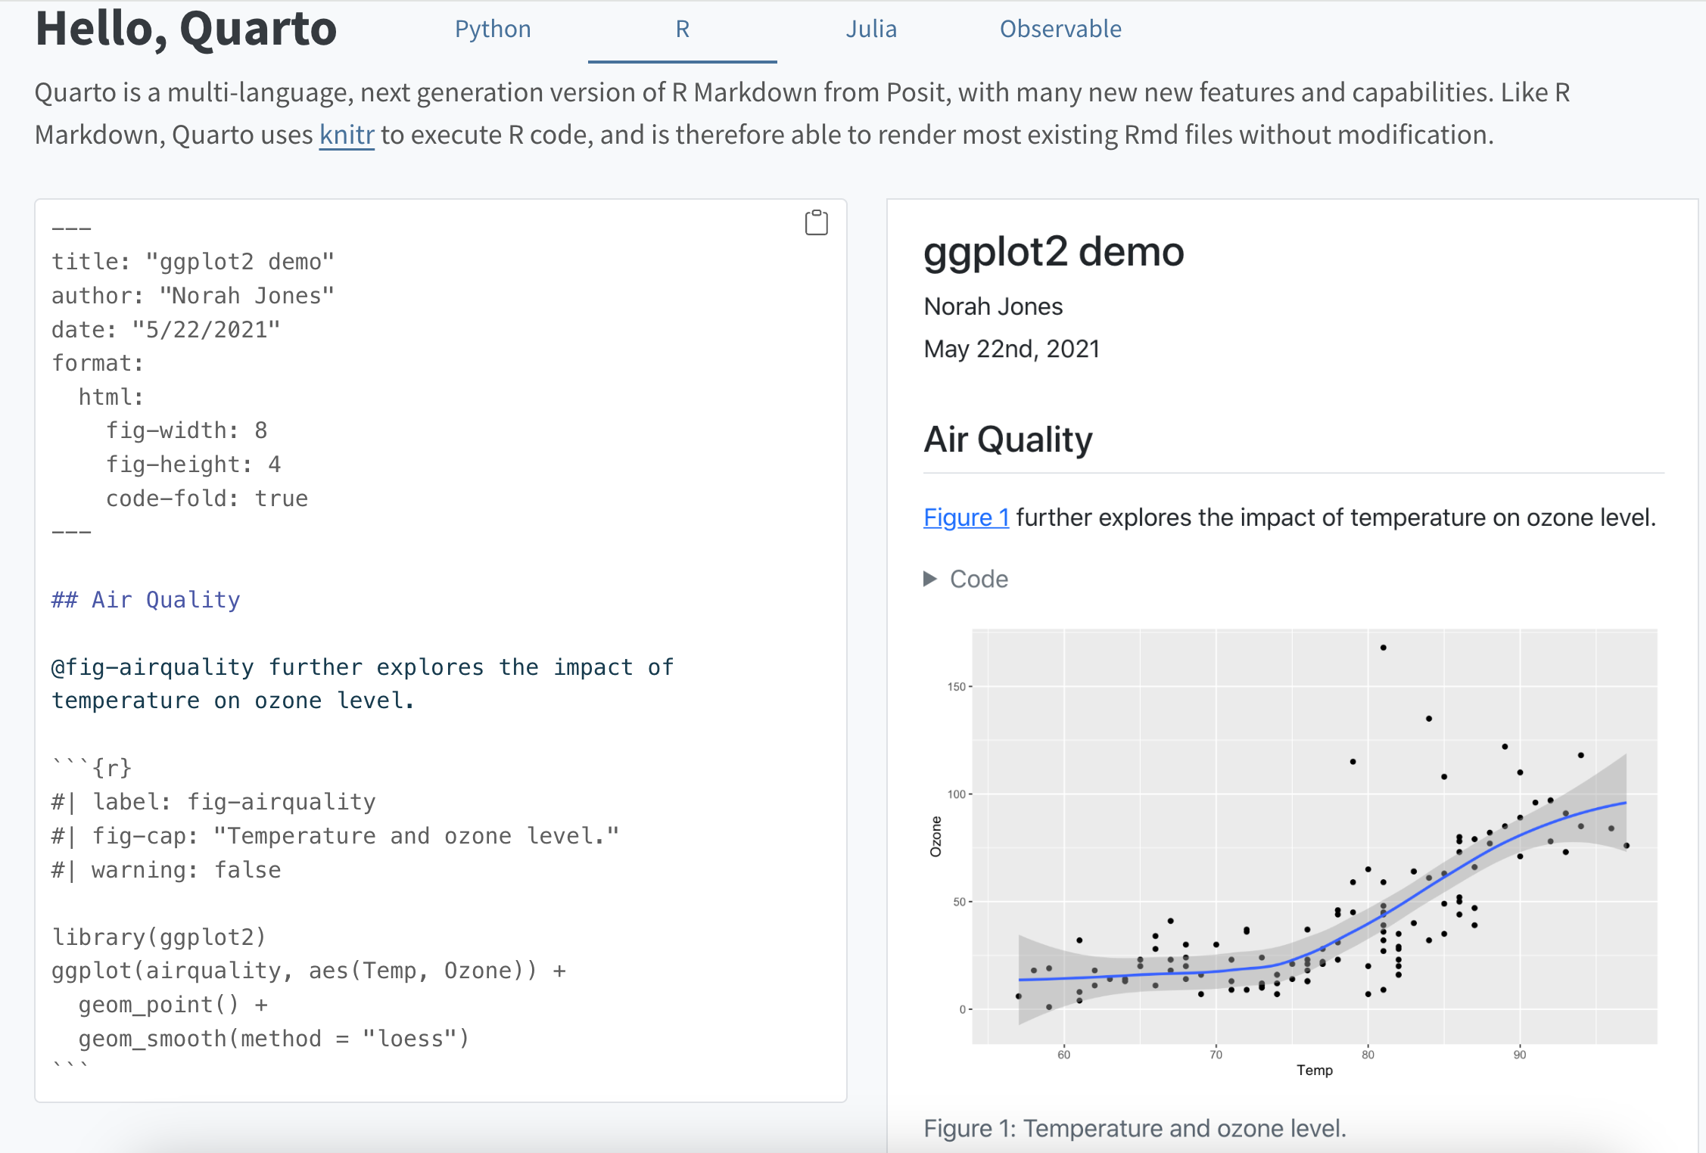
Intro to Quarto
Unified authoring framework
Flat text files (based on Pandoc markdown)
Easy to read and write
Can also execute code directly (supports R, Python, Julia, Observable)
Encourages reproducible analysis

Slide 4
Category | Formats
Documents | HTML, PDF, MS Word, OpenOffice, ePub
Presentations | Reveal.js, PowerPoint, Beamer
Markdown | GitHub, CommonMark, Hugo, Docusaurus
Wikis | MediaWiki, DokuWiki, ZimWiki, Jira Wiki, XWiki
More | JATS, Jupyter, ConTeXt, RTF, reST, AsciiDoc, Org-Mode, Muse, Texinfo, Groff Man Page, Groff Manuscript, Haddock, OPML, Textile, DocBook, InDesign, TEI Simple, FictionBook
Render to many formats

Slide 5
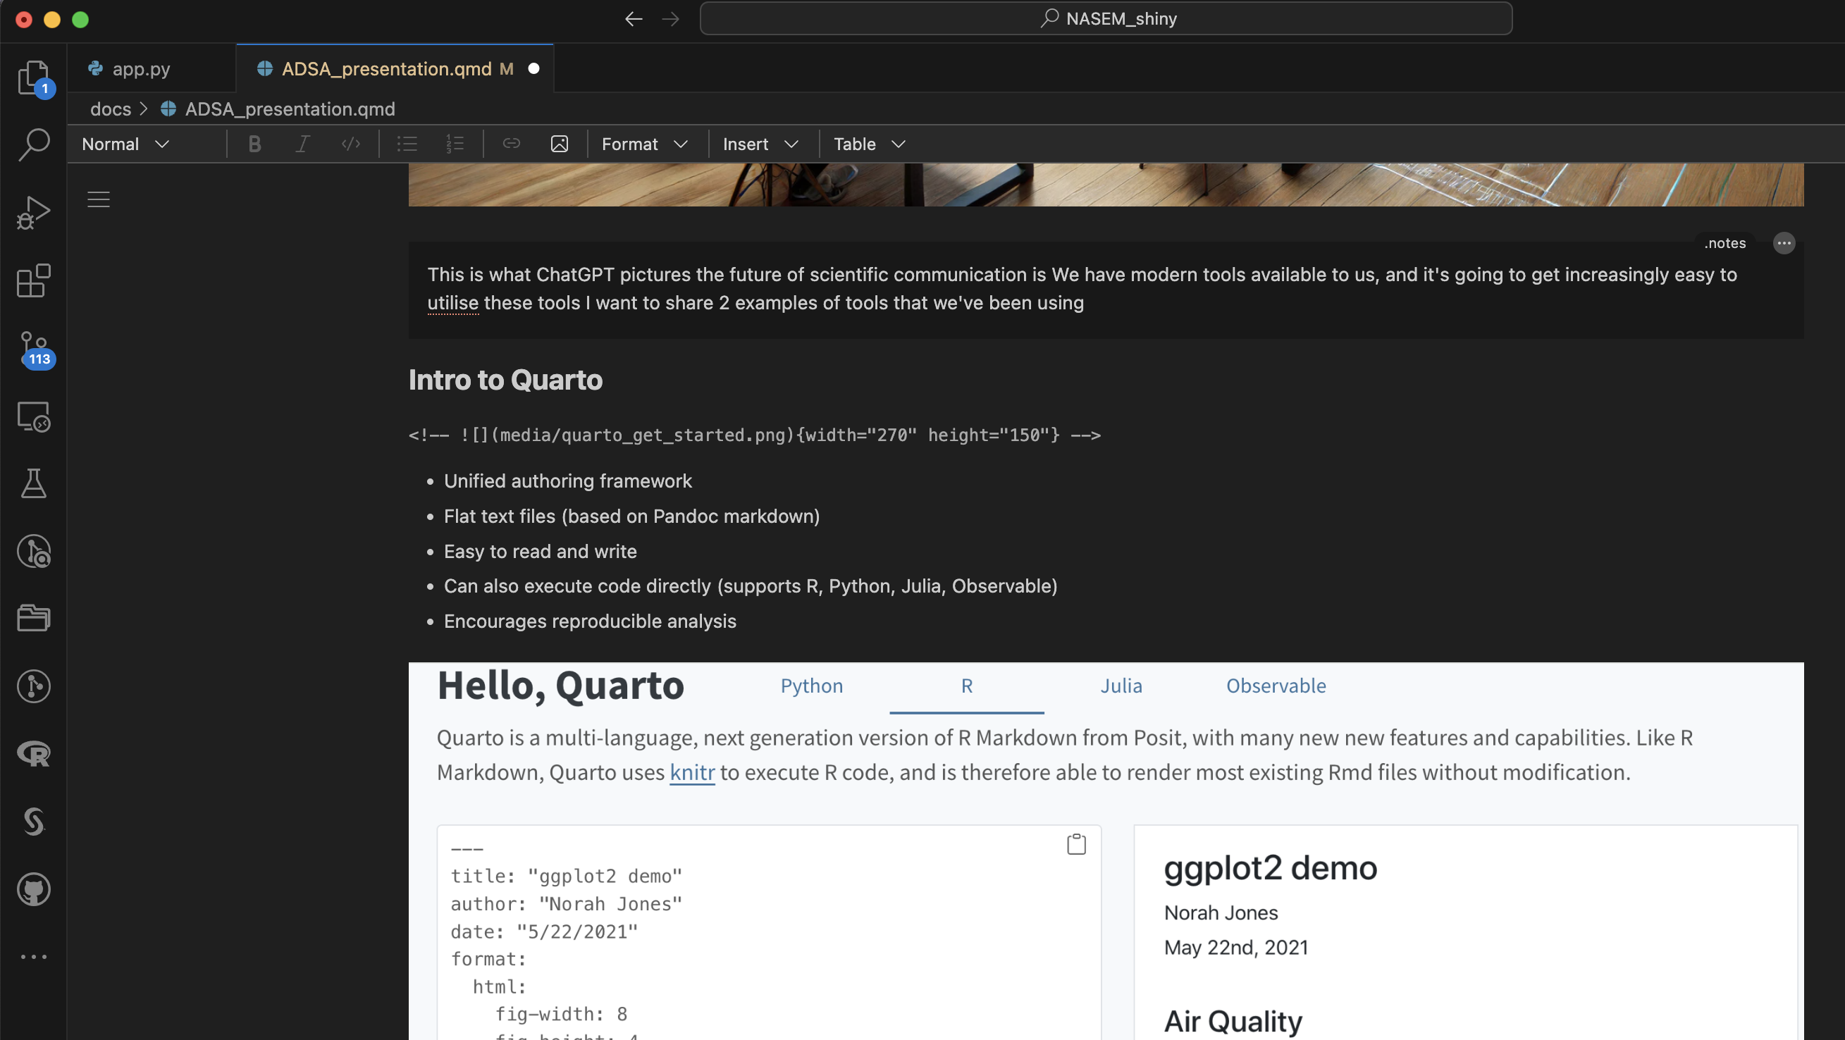
The source code of this presentation
Visual editor for a .qmd file

Slide 6
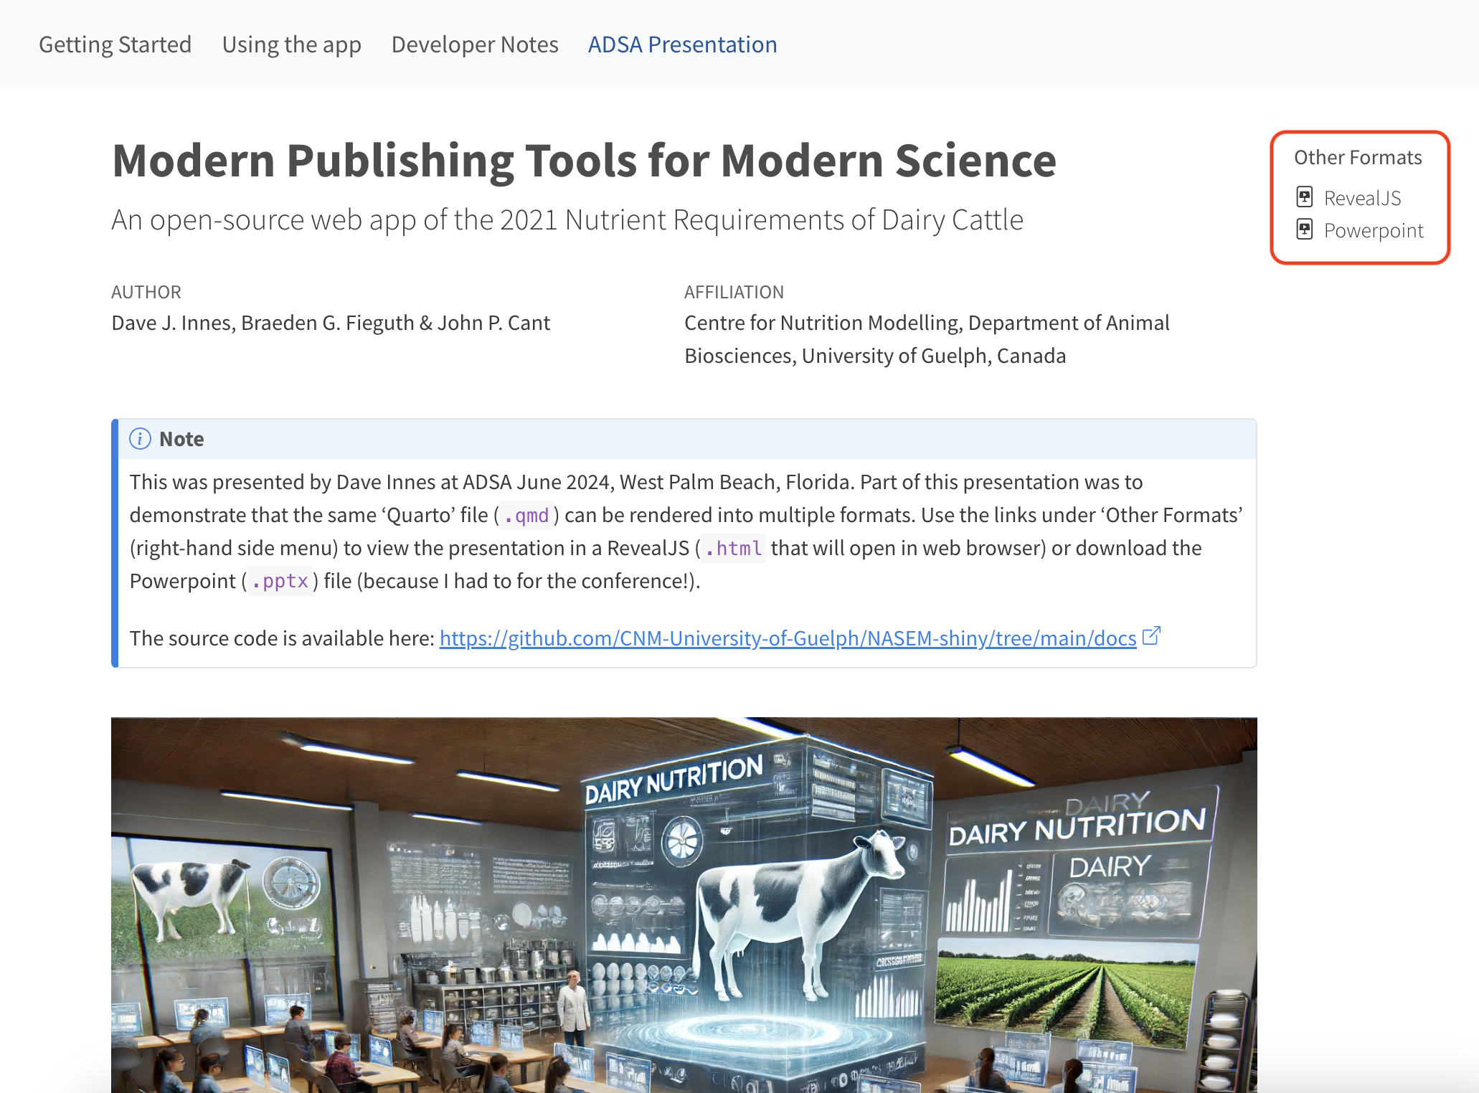
Rendered to multiple formats

Slide 7
Interactivity

Slide 8
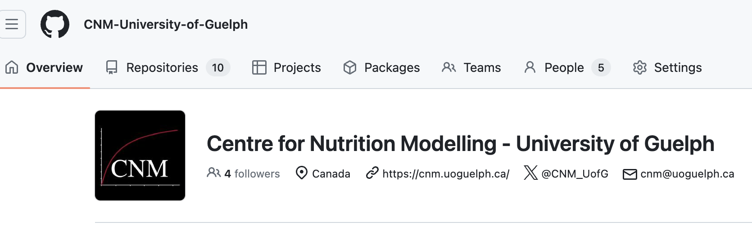
Why develop a Shiny version of NASEM 2021 Model?
NASEM in Python
Open-source, tracked and collaborative
https://github.com/CNM-University-of-Guelph

Slide 9
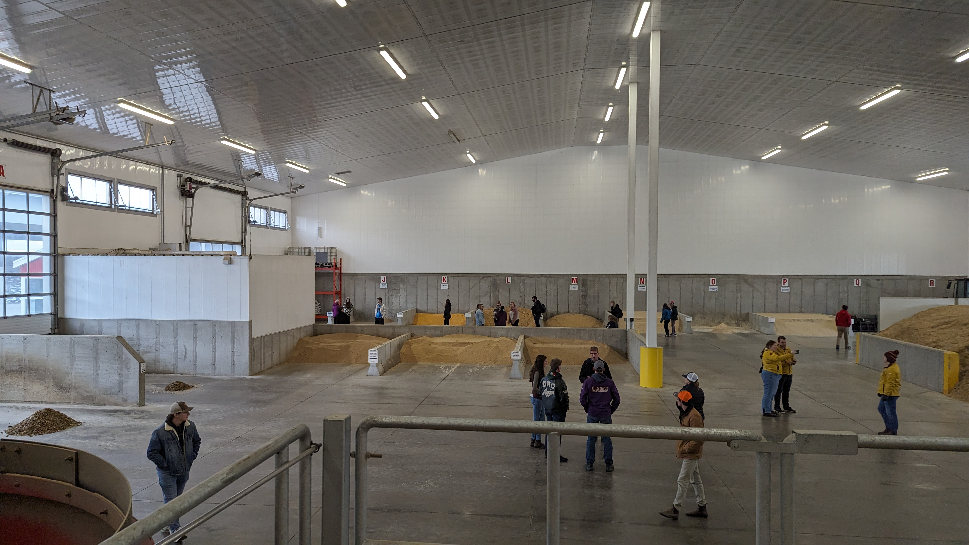
Fourth year Dairy Cattle Nutrition class
45 undergraduate students
Mixed background: ~20% had dairy farm experience
Mostly pre-veterinary degree

Slide 10
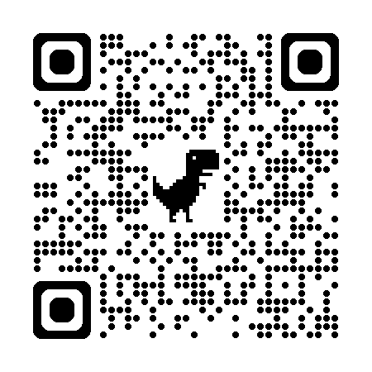
How to teach ration balancing?
Challenges:
Want to teach latest model (NASEM 2021)
Excel sheet used in the past
Software with book:
Complicated for beginners
Only works on Windows
Commercial/industry software:
Expensive
Hard to access
Even more complex
Solution? We built our own!
Web based app
Works on all computers (and mobile phones)
Simplified user experience
https://dave-innes-uog.shinyapps.io/nasem_shiny/

Slide 11
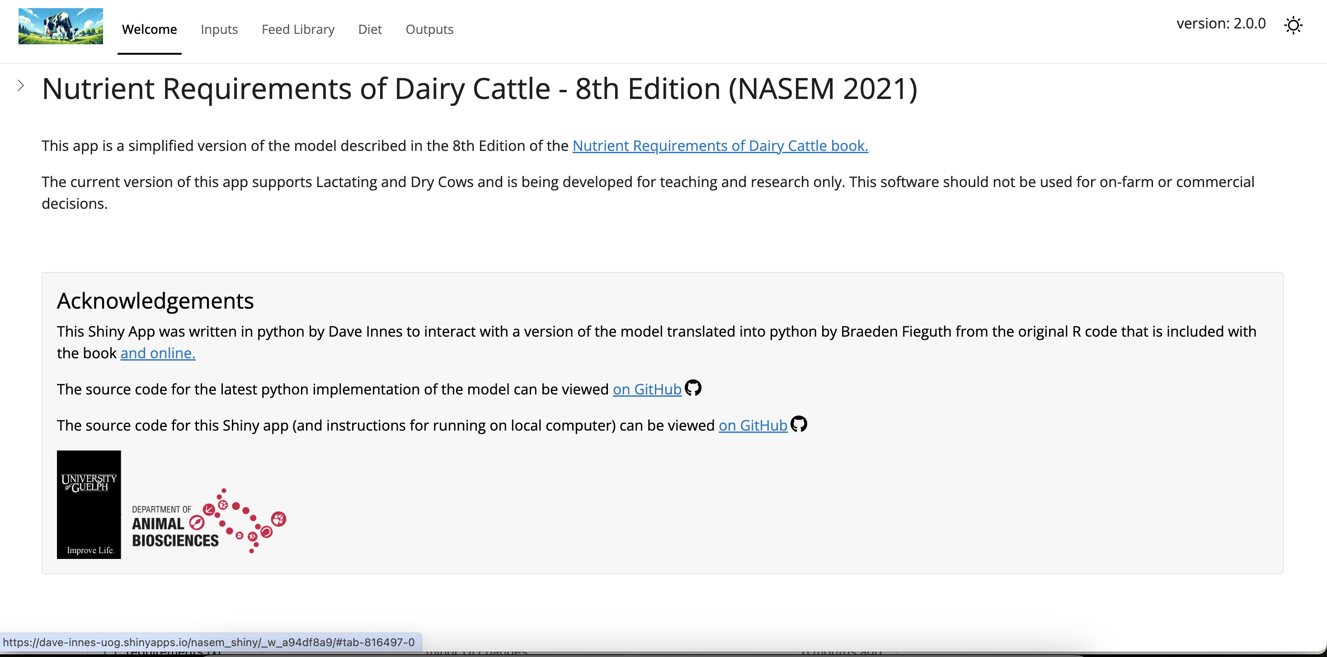
Welcome

Slide 12
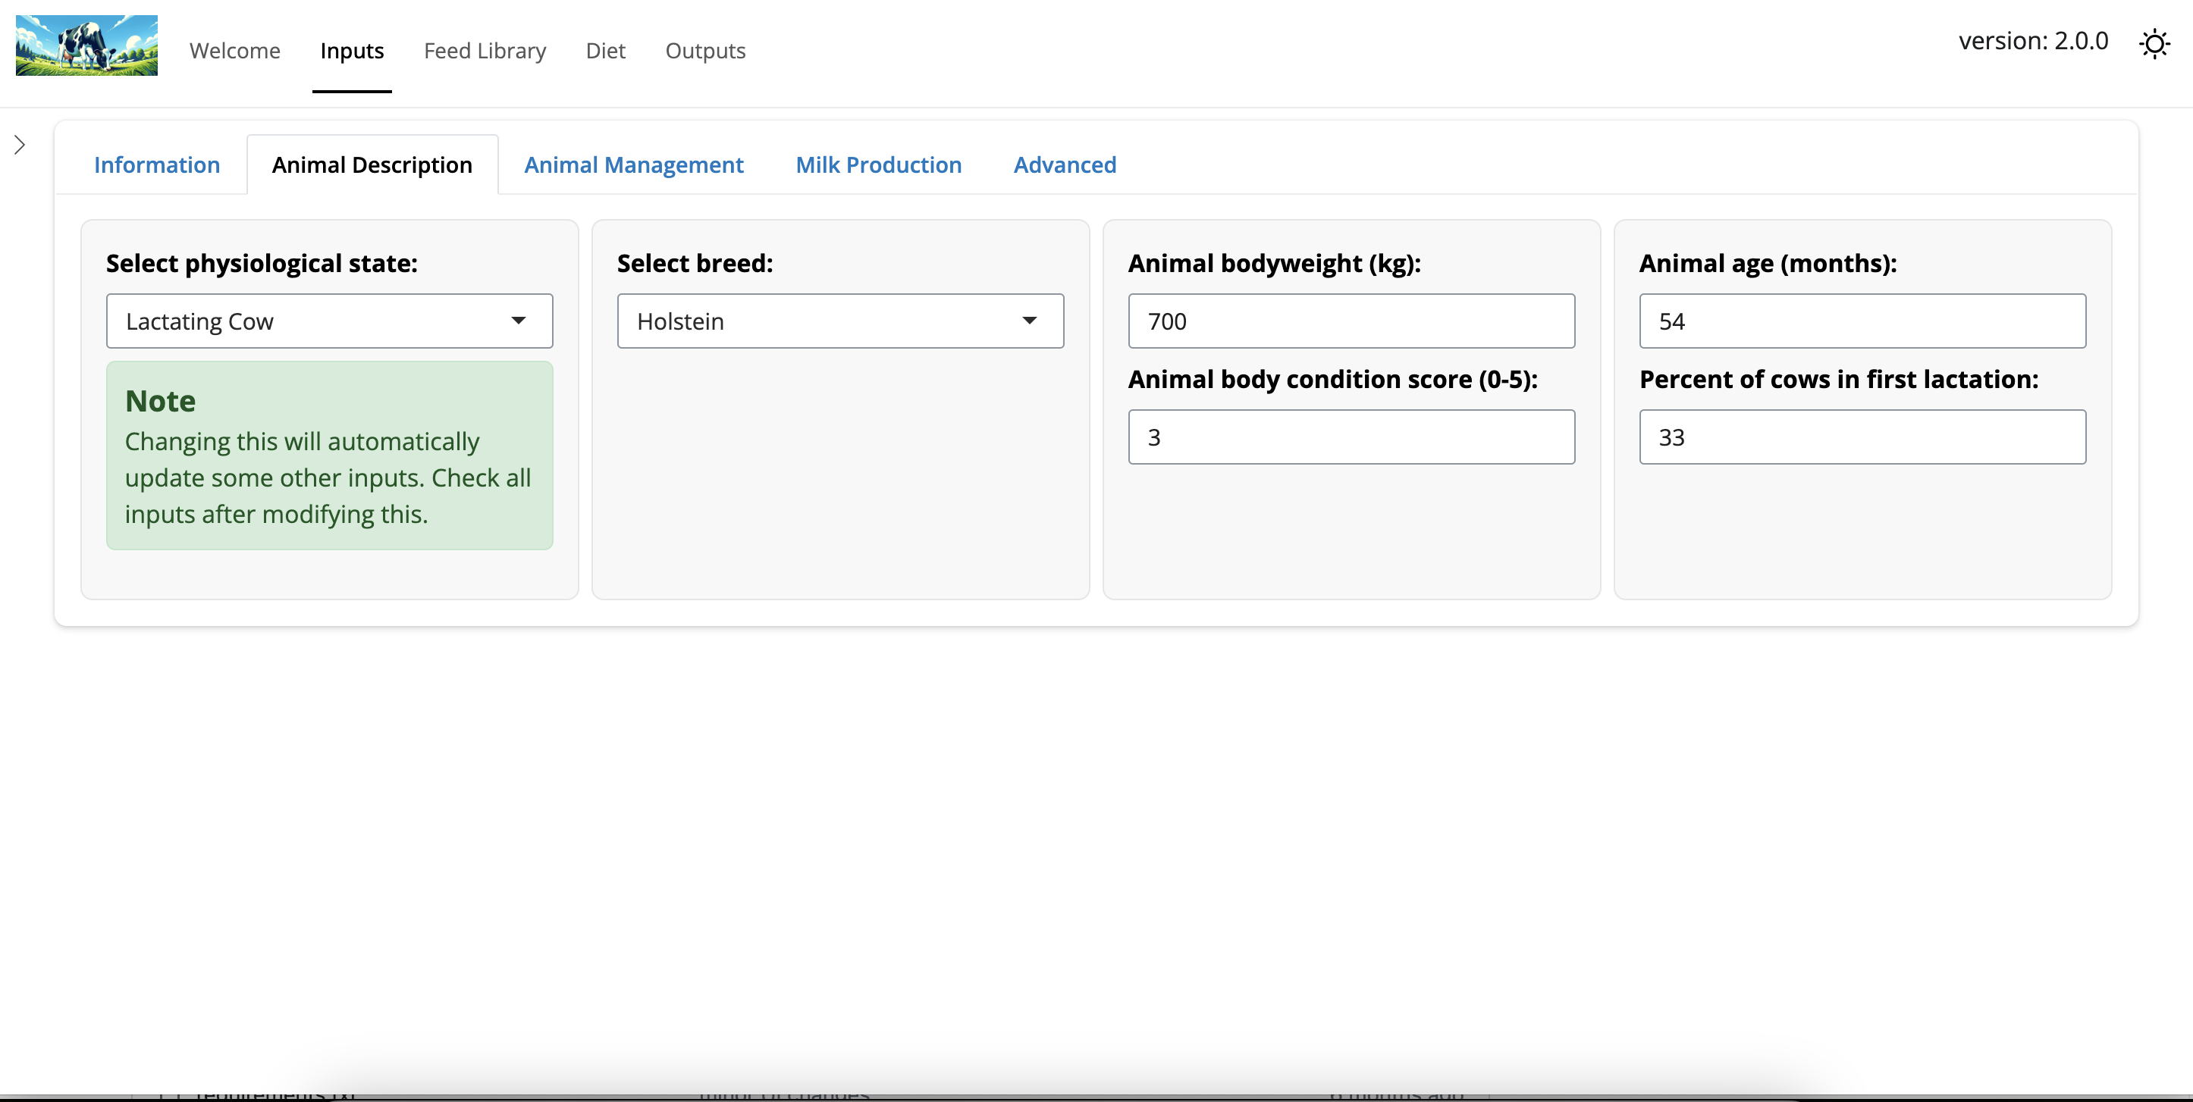
Inputs

Slide 13
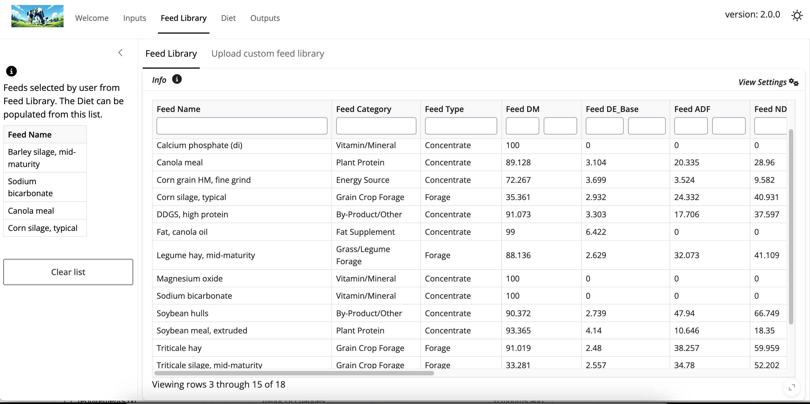
Feed Library

Slide 14
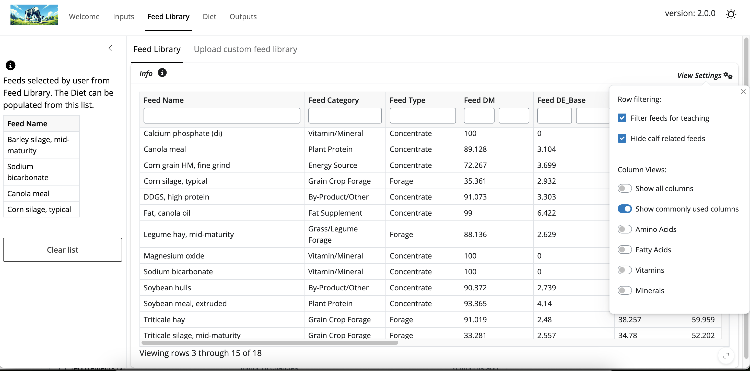
Feed Library - viewer settings

Slide 15
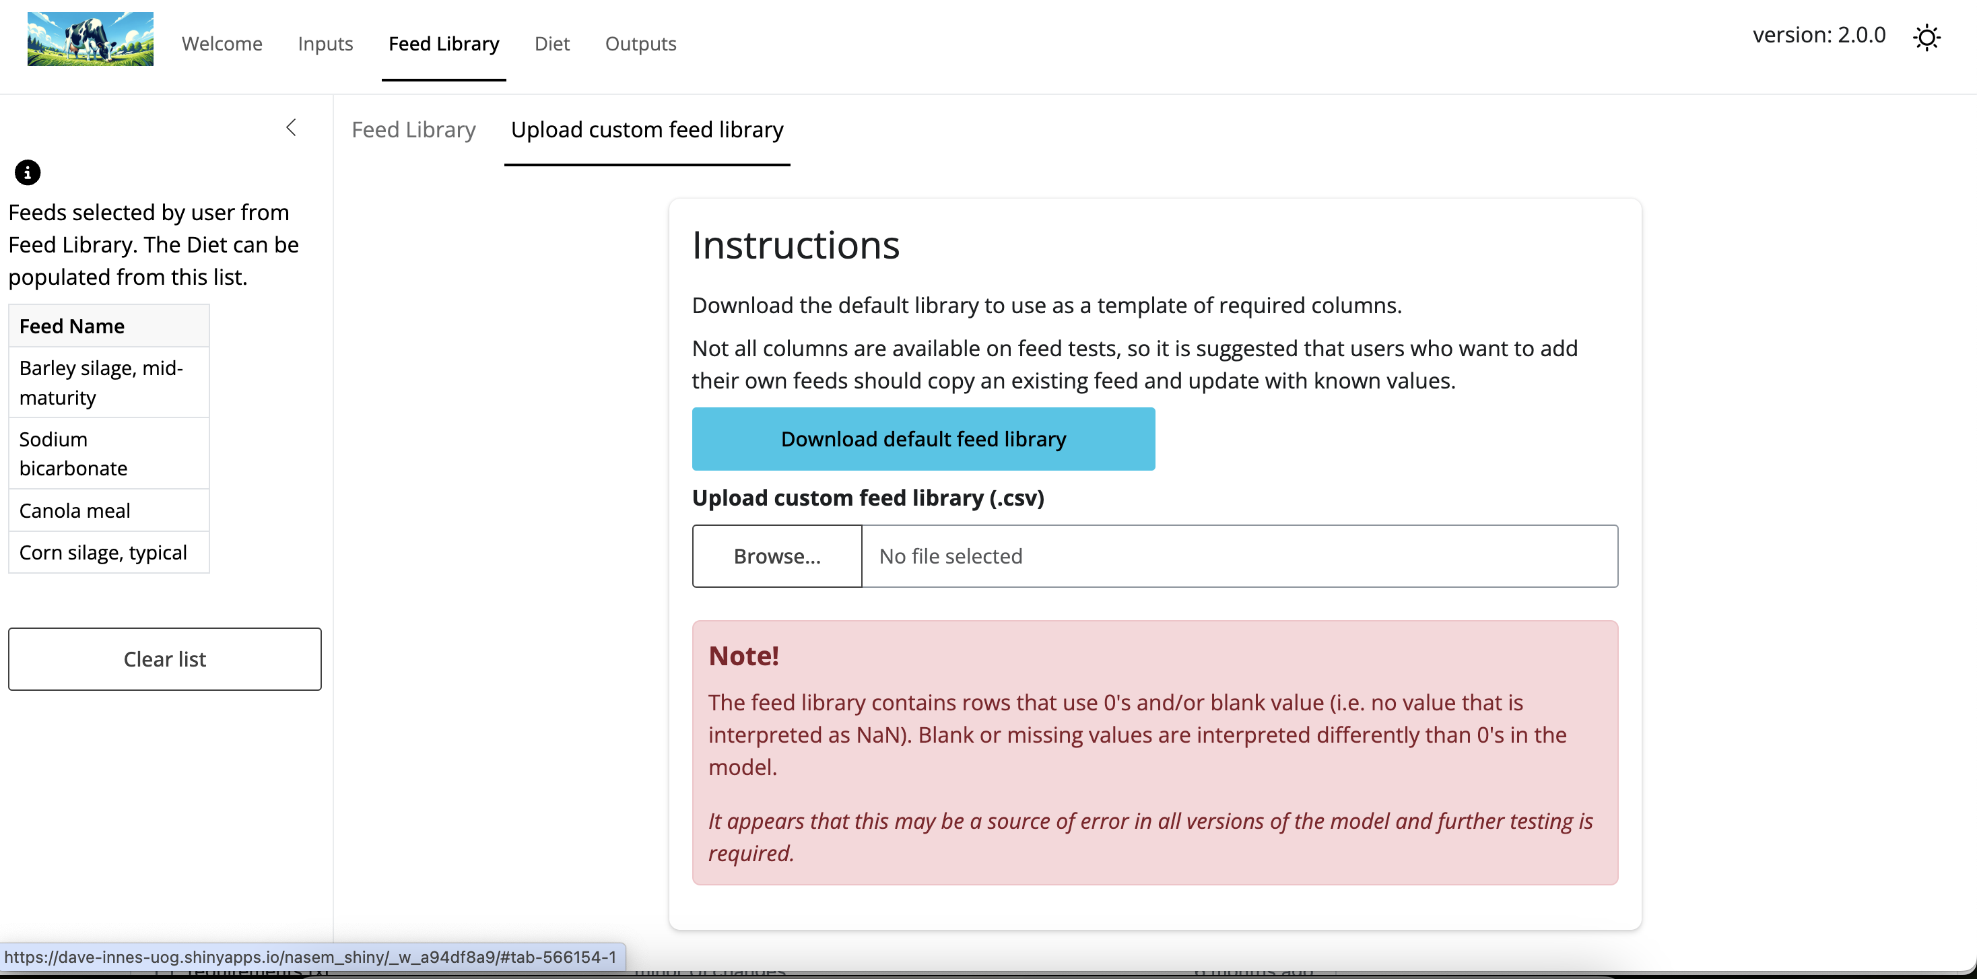
Upload custom feed library

Slide 16
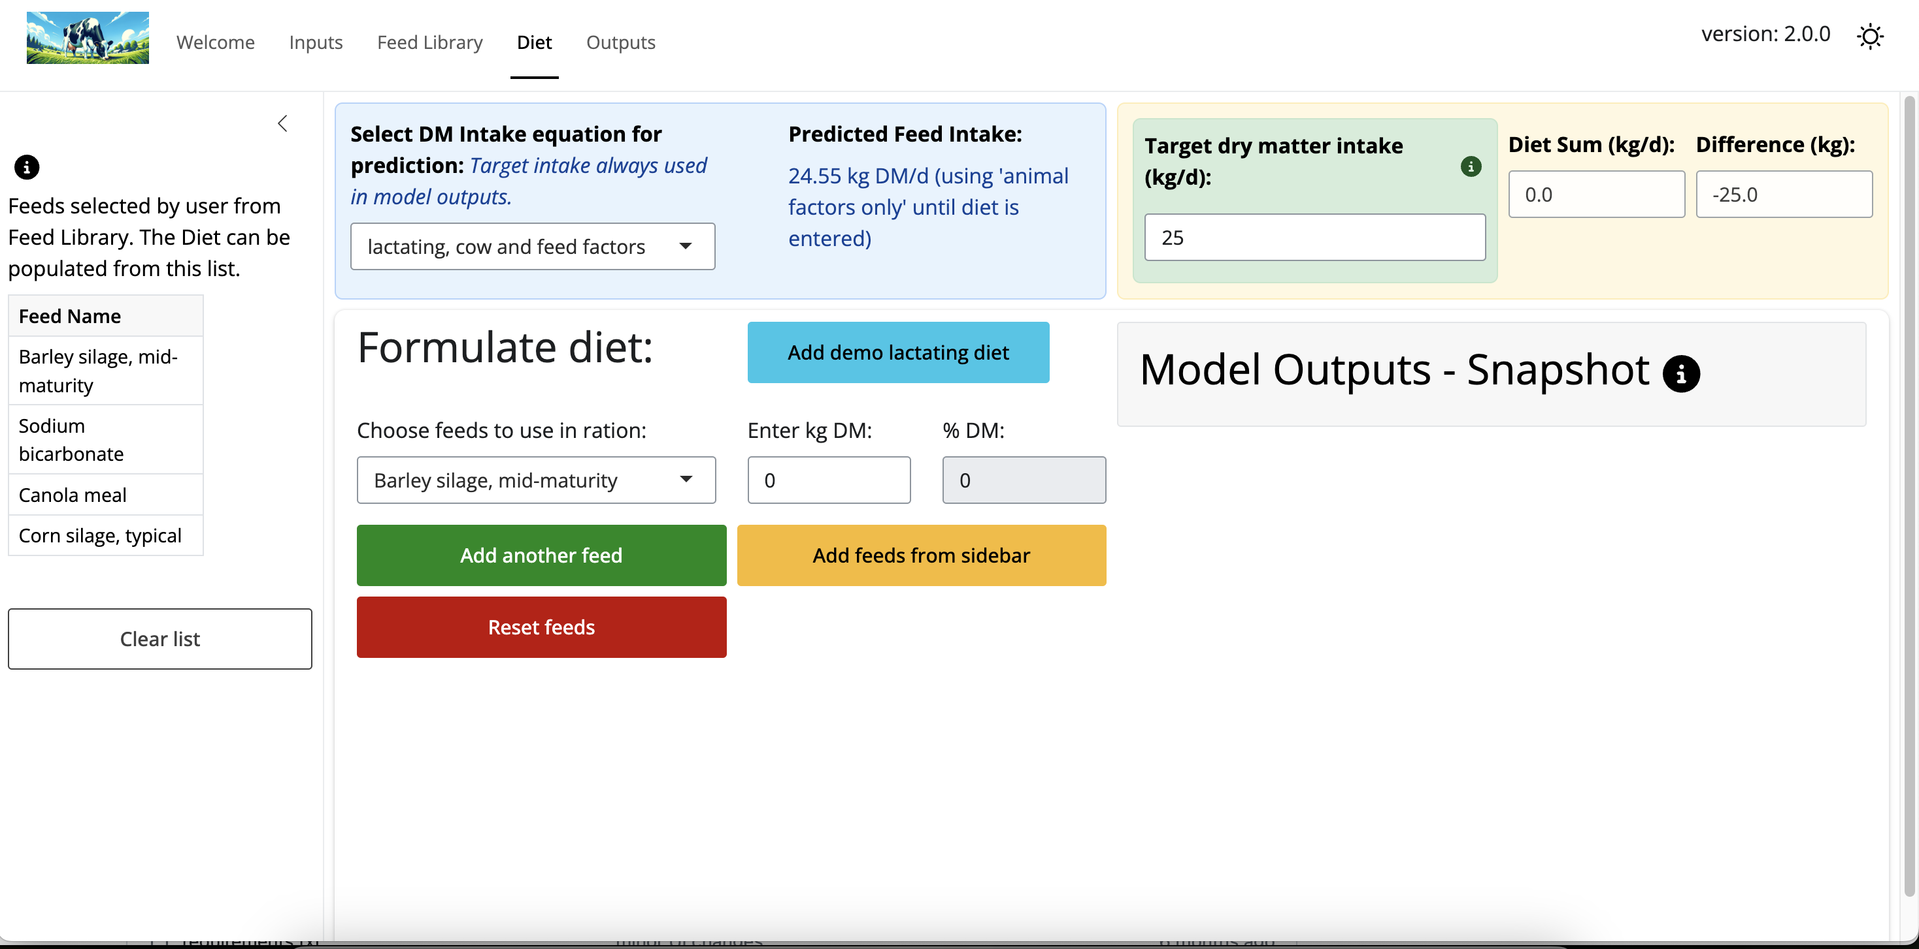
Diet Input

Slide 17
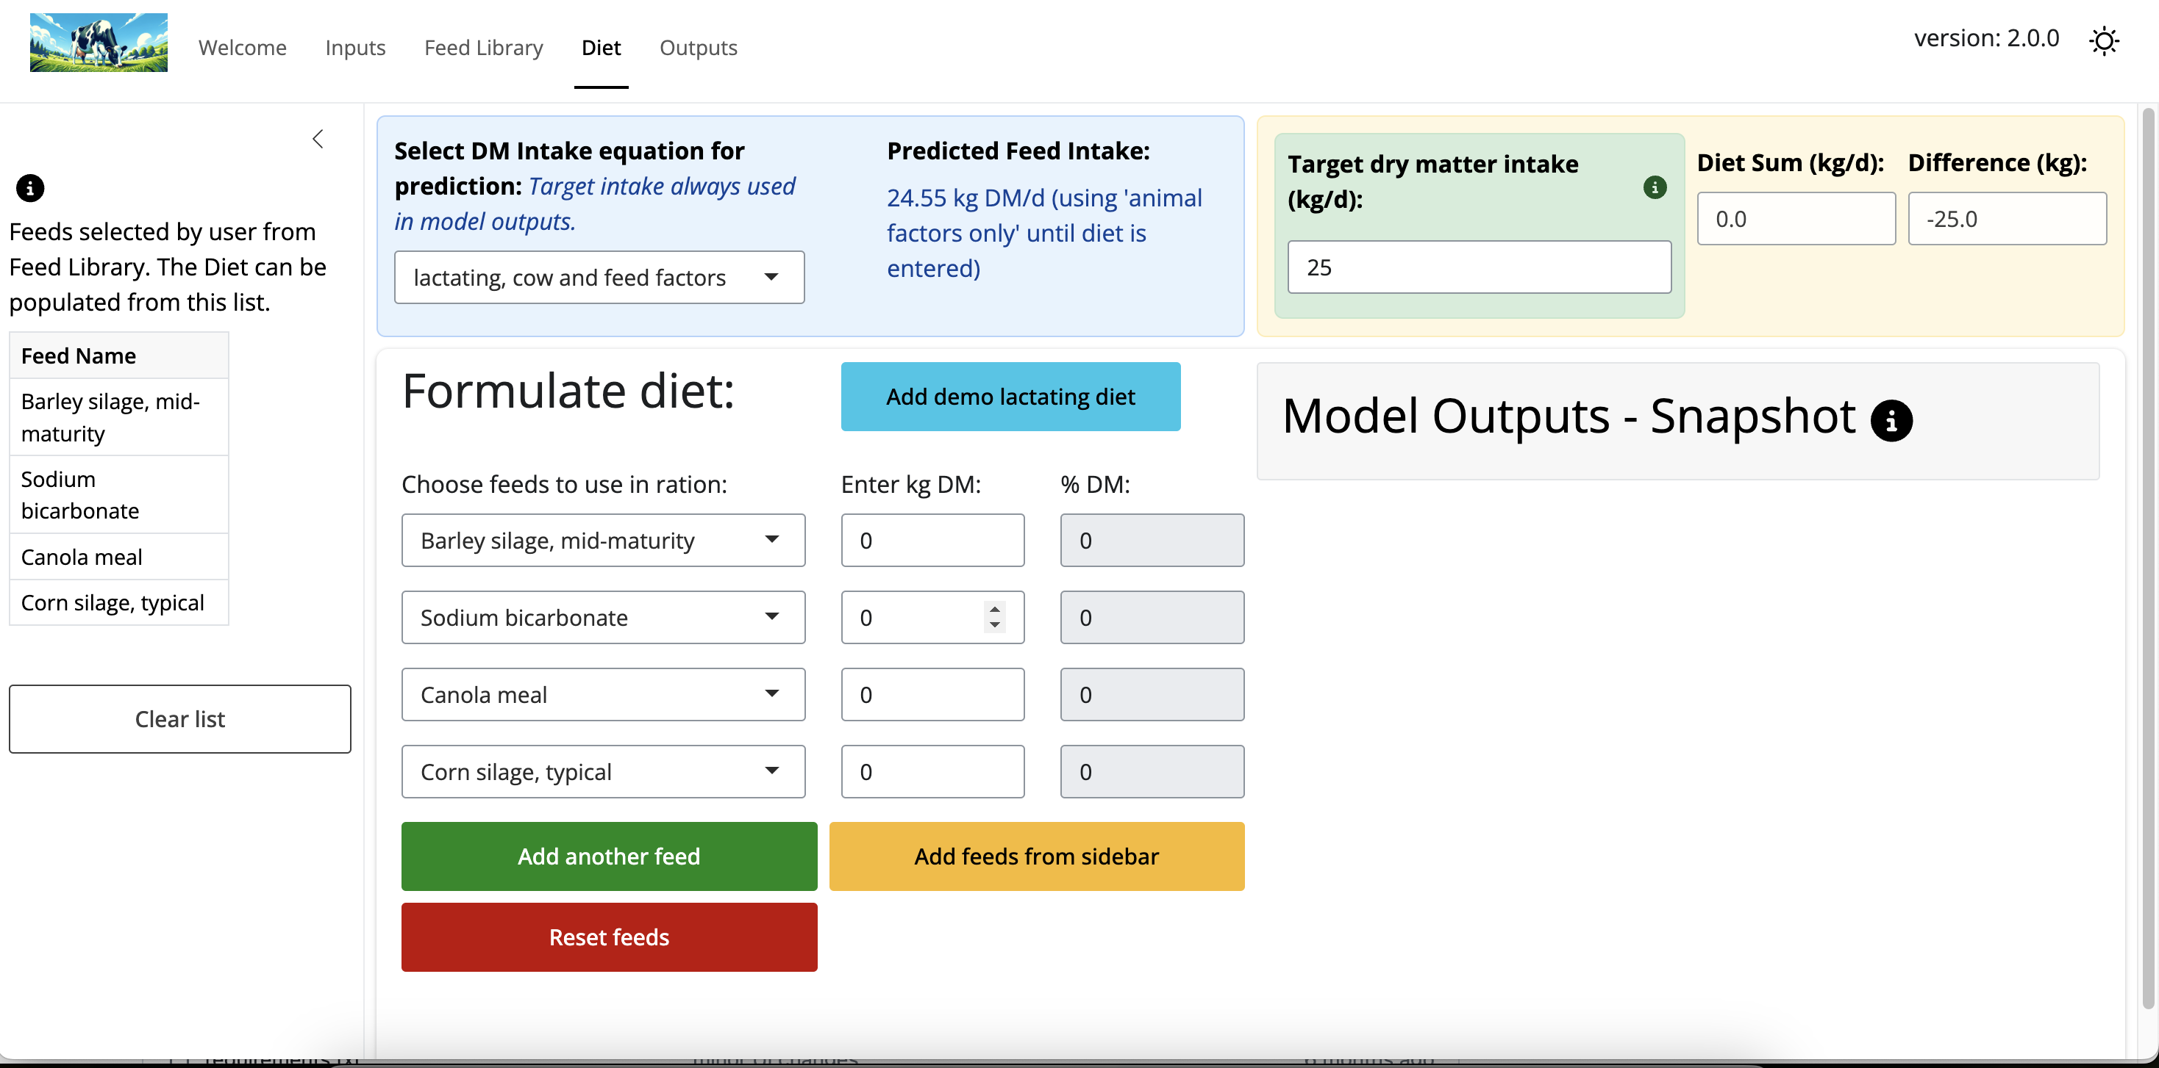
Diet Input - sidebar

Slide 18
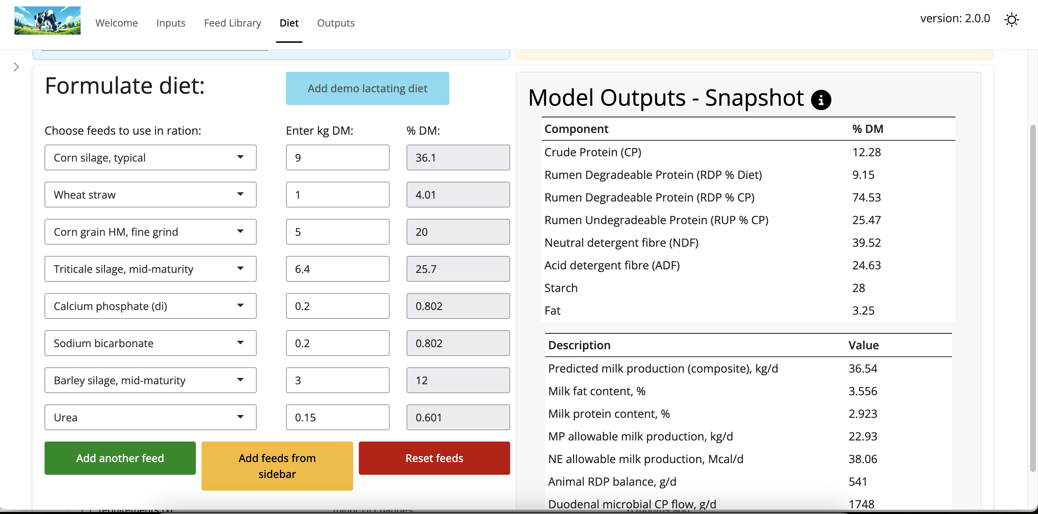
Built-in demo diet

Slide 19
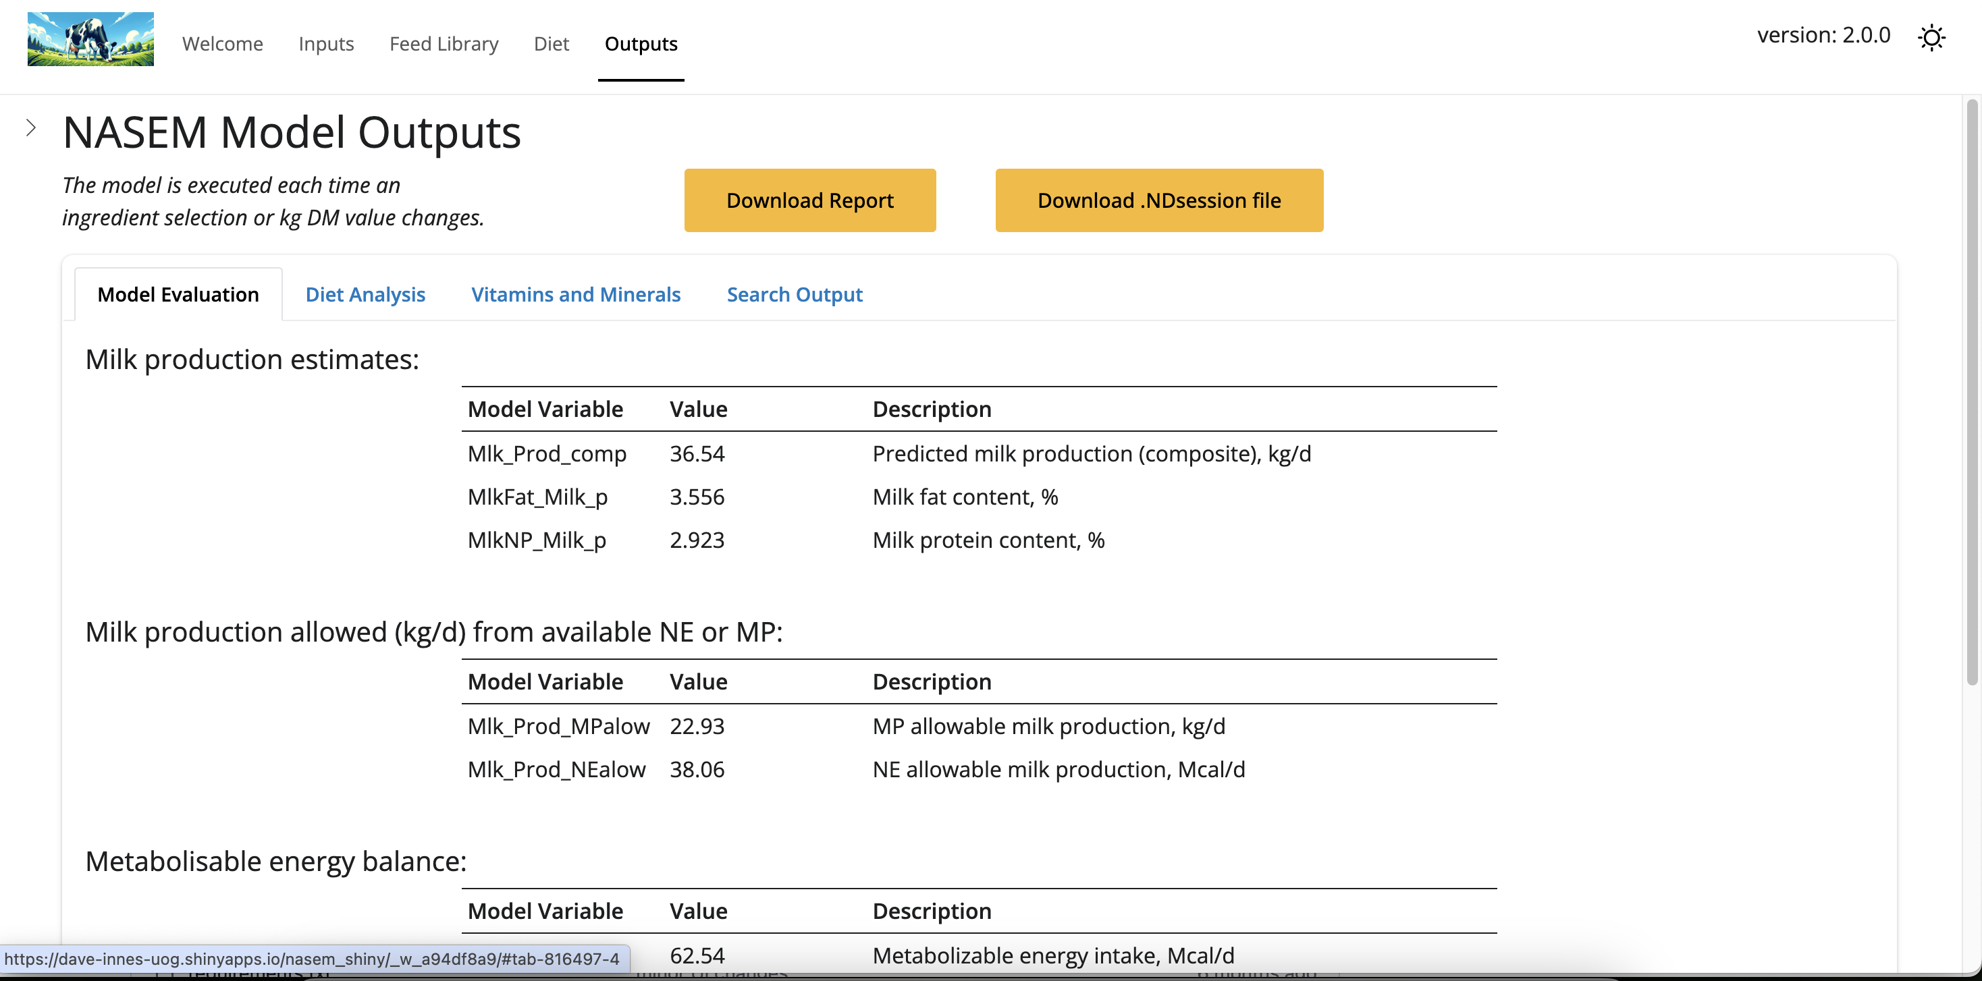
Outputs

Slide 20
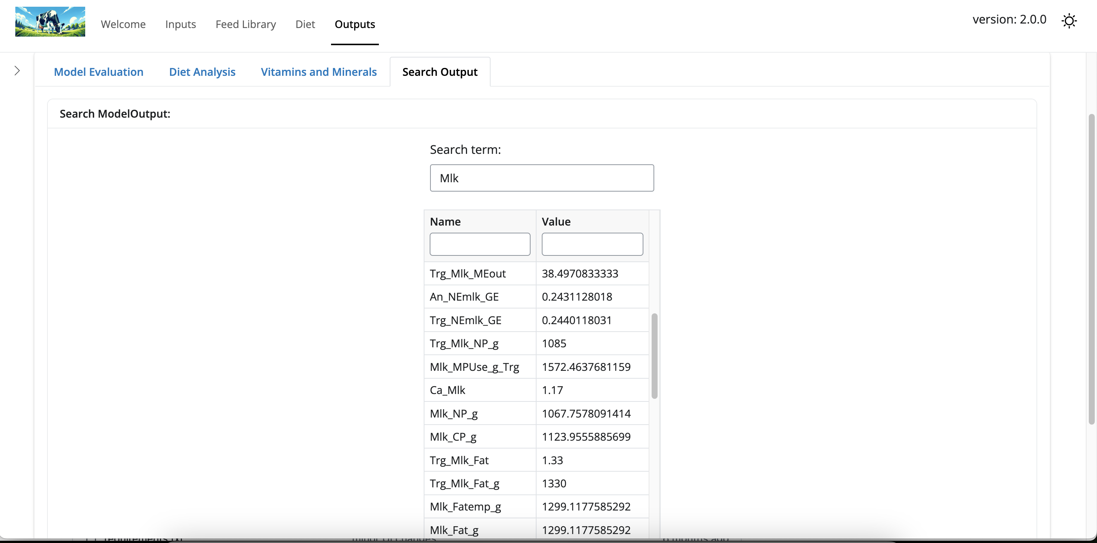
Advanced - search all model outputs

Slide 21
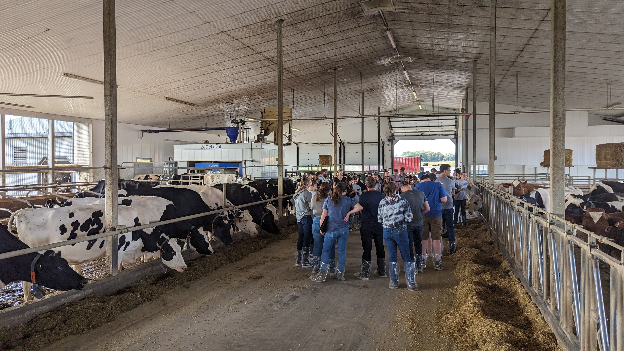
Assignment 1 - early semester
Assignment sheet with steps and screen recordings
Demonstrations in workshops
Pre-loaded scenarios with a clear mistake
Objective:
Get the feel of adding/removing ingredients
Find meaningful outputs in the app
Fix a basic problem
Example Video
How to set up a simulation & load
Assignment 2 - mid semester
Introduce Dry vs Lactating Cow
Read and interpret farm forage analyses
Adding new ingredients to app
Formulating full diets
Case Study Assignment

Slide 22
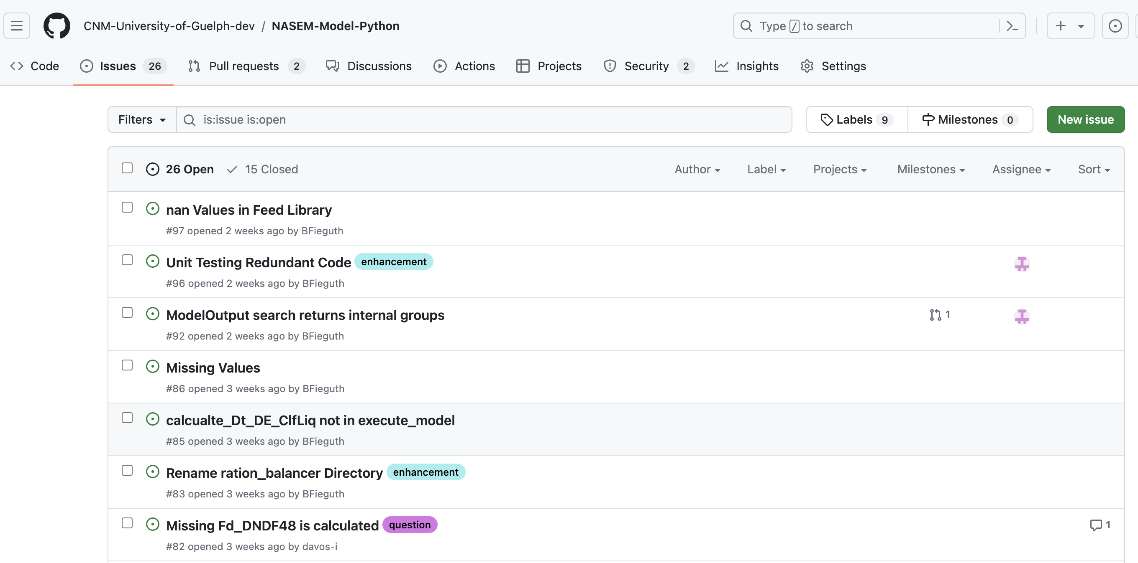
Initial feedback
Early versions couldn’t save sessions
Student’s needed multiple ways to learn it - videos, step-by-step instructions, classroom demo
The app is simplified, but the content was still difficult
Students surprised how hard it was to formulate a ration for a very high producing dairy herd
(It’s a limitation of the model, not the students!)
How to use & contribute?
Open Source - NASEM model & the Shiny App
GitHub - log ‘Issues’ as a user - even if no experience with code
Read the docs - running on own computer or re-deploying custom versions is relatively simple

Slide 23
Conclusions
Quarto is an example of how future publishing can look
Shiny has potential to modernise teaching and research communication
We need to encourage our societies and organising committees to allow these tools to be used in meetings
Collectively sharing resources via an open-source platform will accelerate model improvement
feedback wanted

